Slide 1
Care Home Pack
Updated for Winter 21/22

Slide 2
Winter 2021/22
This quick guide has been put together to help GP’s and their teams prepare for winter for our patients who live in care homes
Practices, hospitals and care homes all under immense pressure
Still legally in a pandemic so many measures from previous waves apply
Checklist to help with preparation

Slide 3
Quick Guide
Checklist
ACP
DNACPR
JIC Medication
Repurposing Medication
Palliative Care Guidelines
Oxygen Concentrators
Confirmation of Death
Support available

Slide 4
Checklist to review for all care home
patients
ACP - review, update and document in KIS
DNACPR - if appropriate put in place, once discussed with patient/NOK/legal representative and document in KIS
JIC medication stock - check or ask care home to check stock
JIC medication preauthorisation forms, check all new patients have these - initiated in May 2020
Oxygen concentrators - check care homes still have these

Slide 5
ACP
Check if the care home have an ACP for each patient - what discussions have been had recently? Record significant family discussions and any significant changes in patient's health
Update and if previous plan no longer appropriate, discuss with patient/NOK/legal representative
Ensure these are on KIS special notes
Especially wishes re admission to hospital
Other valuable information for OOH Dr including normal sat's in COPD or eGFR if reduced renal function and the date KIS is updated

Slide 6
ACP
Remember to emphasise what can be provided in nursing home
  Oxygen
  JIC medication
  SC fluids (through CHLN)
  Blood tests
  Care by team who know them including GP and carers and nurses and support of CHLN
  Own bed/home comforts/familiar faces

Slide 7
ACP
Resources
Paperwork suggestion for scenarios to cover during discussion
    https://www.rcgp.org.uk/clinical-and-research/resources/bright-ideas/anticipatory-care-planning-in-three-questions.aspx
Video on having conversation
  REDMAP - https://rcpsg.ac.uk/college/covid-19/digital-education/using-red-map-talking-about-planning-care-death-and-dying
Webinar on ACP and why and how we do it with Dr Kathryn Mannix
  https://1drv.ms/v/s!Ap_YwKI6VZFAgXIVVMZCdRSMEOPO?e=bmvbpw

Slide 8
DNACPR
Make this part of ACP discussion and ensure understanding is there and reassure that DNACPR does not mean patient will not have access to other types of care
Is a medical decision but legally MUST be discussed with the patient or their representative
Review those who do and do not have these in place in you care homes and ensure, if present, have been discussed
Please code this on KIS

Slide 9
DNACPR
Success of CPR depends on how you are physically moments before heart stops
Successful when heart goes first not last
Cannot reverse years of frailty
If over 75 and one other significant illness such as frailty or reduced renal function for example then success is <1% and can cause real harm and prevent normal dignified dying

Slide 10
DNACPR
Resources
  Information for families
    https://www.nhsinform.scot/care-support-and-rights/palliative-care/planning-for-the-future/decisions-about-cpr
  Webinar (2nd half of this recording)
    https://us02web.zoom.us/rec/share/oHUkJhS7ih7nd2YCL-QEPe1xFnzGD7cFe5GFSdlIDps71j0C1tPI1MxgMycof8g_.mxCow7oQ5lC6BPmH
      Passcode g!OCdZB1

Slide 11
Just in case medication
STOCK
This document has the list of what should be in the care homes/residential care homes
  https://www.palliativecareggc.org.uk/wp-content/uploads/2020/05/Covid-19-S247-PART-A-GP-protocol-PC-in-care-homes-V2.0.pdf
Ask the care home to check stock and you can request those needed on stock order forms
Prescribing support pharmacist may be able to support with this if they are a prescriber

Slide 12
Just in case medication
  Reminder of protocol
    Residential care homes – Level 1 medications
    Nursing care homes – Level 1 and Level 2 medications
Level 1 – Paracetamol/Codeine Linctus/Buccastem/Kwells/Scopoderm/Biotene
Level 2 - Levomepromazine/Haloperidol/ Hyoscine Butylbromide/Doxycycline/Amoxicillin

Slide 13
Just in case medication
PREAUTHORISATION FORMS
You will need to sign a pre-authorisation form for all your patients in a care home to allow these medications to then be given
Consider when last updated and do form for any new patients in care home since May 2020
Prescribing support pharmacist may be able to help
Forms here
  https://www.palliativecareggc.org.uk/wp-content/uploads/2020/05/Covid-19-S247-PART-A-GP-protocol-PC-in-care-homes-V2.0.pdf

Slide 14
Repurposing of medication
See next slide for summary of the GGC policy
Allowing the medicines from one resident (the donor) to be administered to another resident (the recipient) to allow immediate treatment where access to medication is not possible via normal routes. Controlled Drugs (CDs) can be repurposed.

Slide 15
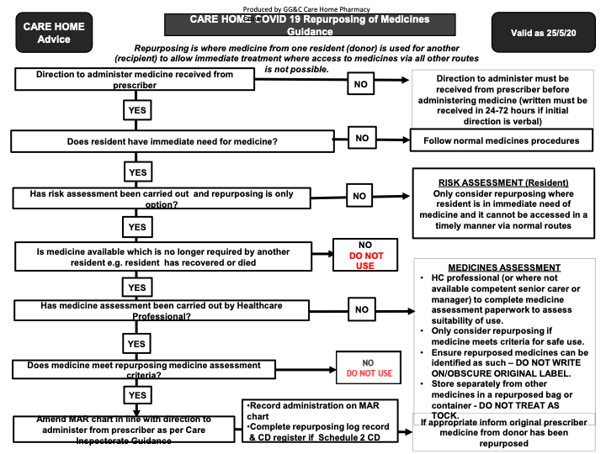

Slide 16
Palliative care guidelines
Link to up to date palliative care guidelines online
  https://www.palliativecareguidelines.scot.nhs.uk/

Slide 17
Oxygen Concentrators
Agreement in GGC that care homes can continue to have concentrator
If your care home no longer has one and you think it would be of benefit call community respiratory team
  QEUH/GGH/Vic - 451 6073
  Clyde - 314 7400
  GRI/Stobhill - 211 4402
Can consider if saturation’s <92% along with other palliative measures
Not single use but do need cleaning often – care homes have information pack and know to do this
If patient needs one then next working day call CRT and they can ask Dolby to supply one on named patient basis and replace the standby concentrator.

Slide 18
Confirmation of death
Nursing home nursing staff should all have completed online training on this so VOED forms should no longer be needed – if residential care home, DN’s can do if patient is known to them
CHLN’s can support with the training if not been completed
Resources for this and the electronic Confirmation of Death form to be completed can be found here
  https://www.palliativecareggc.org.uk/?page_id=5609

Slide 19
Support for you!
Reminder to look after yourself, many of us are hanging on by a thread under the current workload and pressure!
If struggling please let someone know and ask for help, speak to your GP or colleagues
Workforce specialist service now available, reactive, confidential and self refer
  https://www.practitionerhealth.nhs.uk/media/content/files/WSS%20Leaflet_online.pdf
  Also wellbeing hub
  https://wellbeinghub.scot/
Take care

Slide 20
Thank you for all you do!

