Slide 1

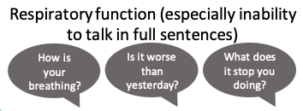
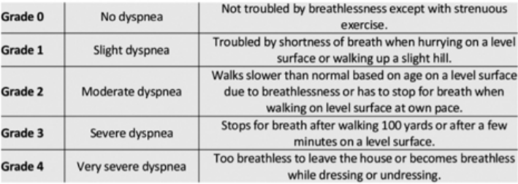


GP Advice 10
Produced by GG&C PC Clinical Advisory Group
20/12/21
GG & C COVID 19 Pathway v10 WINTER 2021 V5
Phone call for COVID19 Concern
Covid Pathway Overflow
If the Covid Pathway services i.e.
Covid- 19 HUB (Advice)
Community Assessment Centres (Face to face)*
Covid-19 Home Visit Service
are full or unavailable then calls may be passed to practices for assessment or review.
*If the CACs are full the practice may be asked to review the patient to decide if the patient can wait to be seen after 6.30pm by the OOH service.
FEVER
OR
LOSS/CHANGE IN TASTE/SMELL
OR
COUGH
Telephone Assessment
New Breathlessness
MMRC>1
OR
Clinical concern or
Significantly unwell
Assessed as direct to SATA
Clinician decides on face to face clinical assessment
AGED OVER 12
AGED UNDER 12
Positive PCR OR Close Family contact
Covid-19
Community Assessment
Pathway
HAD 2 Vaccinations & Negative PCR and NO Close Family contact
Negative PCR or None and NO Close Family contact
Positive PCR or none &/or NOT had 2 Vaccinations &/or Close Family contact
YES
NO
General Practice Assessment (Face to face)
Pathway Home Visit
If not available
Clinical Assessment
Patient Transport Service is usually available to take patients, who have no other means of transport, to the CACs.
Key symptom : BREATHLESSNESS
O2 Sat <92%
COPD <known baseline or <88%
Respiratory Rate $≥$22
NEWS Score > 2
Pulse > 110
OR
Clinical Concern
RED FLAGS
Severe SOB at rest
Chest Pain
Blue lips or face
Difficulty breathing
Clammy, cold or mottled skin
Poor urine output
Difficult to rouse
Haemoptysis
Covid-19 Assessment centres are set up to assess severity of Covid-19 illness. They are not well suited to assessment of other conditions which would need to be further assessed and managed by the patient’s practice.
If GP thinks there is another reason patients needs referral to CAC, please state in the referral.
If assessment satisfactory-
Self Care Advice + Worsening Advice
(Based on getting breathless)
Phone Hospital & COVID19 Referral
(SCI Gateway)
MMRC DYSPNOEA Scale
Secondary Care Assessment/SATA

