Slide 1
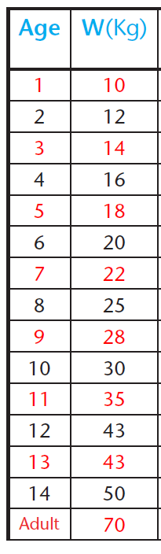
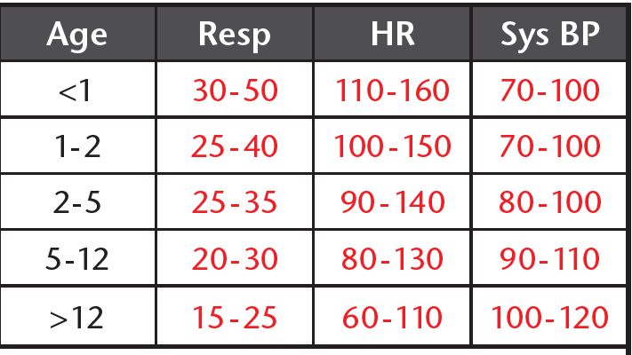

GP Advice 5
Produced by GG&C PC Clinical Advisory Group
21/12/21
GG & C GP Practice COVID19 CHILD Triage Pathway v20
Phone call for Respiratory Systems/COVID19 Concern
RED – Severe symptoms or high risk
A – No response to social cues, does
not wake/stay awake if roused,
high pitched/continuous crying
B – Grunting, RR>20 above normal,
severe indrawing
C – Pale, mottled
D – T>38 if <3m, non-blanching rash,
bulging fontanelle
AMBER – Moderate symptoms
A – Not responding normally, no
smile, wakens with prolonged
stimulation, significant decreased
activity
C – Dry mucus membranes, poor.
feeding, reduced urine output,
pale
D – Fever ≧ 5 days, rigors
GREEN – Mild symptoms
A – Responsive to social cues,
smiles, stays awake,
strong/normal cry
B – No distress
C – Moist mucus membranes,
normal colour
Assessed on the phone as significantly unwell
Needs Clinical Assessment
Self Care Advice + Worsening Advice
(Based on Red or Amber symptoms)
NO
Positive PCR OR Close Family contact?
General Practice Assessment (Face to face)
YES
Covid-19
Community Assessment
Pathway
AMBER –Symptoms above
AND
B
Nasal flare
Resp Rate raised
O2 Sat ≦95%
Crepitations
C
HR raised
CRT ≧3 secs
Dry mucus membranes
Poor feeding
Reduced urine output
Pale
D
Fever ≧ 5 days
Rigors
PEWS raised but < 2
GREEN – Mild symptoms as above
AND
B
No distress
C
Moist mucus membranes
Normal colour
D
No red/amber signs
PEWS 0
Discuss with Paediatrician
Via Consultant Connect
Remember that a child is
more likely to be unwell with other illnesses than coronavirus
Secondary Care Assessment
Reference Information
PEWS | 0 | 1 | 3
Cardiovascular | Pink or Capillary refill <2 secs. Within baseline | Pale or capillary 2-4 seconds | Grey or capillary refill 4 seconds Tachycardia >10/bpm above normal in <11yrs >20/bpm above normal in >12years)
 | Within baseline. Normal effort Room air. (SpO2 >94%) | Any O2 requirement. Intercostal/Subcostal recession <20/min above normal in 0-2years <10/min above normal in > 2years (SpO2 92-93%) | Sternal recession >20/min above normal in 0-2years >10/min above normal in > 2years (SpO2 <92% in air)
Behaviour | Alert/Asleep Playful. | Consolable | Alert to verbal/pain/Unresponsive
Online PEWS Score Calculator
https://www.mdcalc.com/pediatric-early-warning-score-pews

