Slide 1

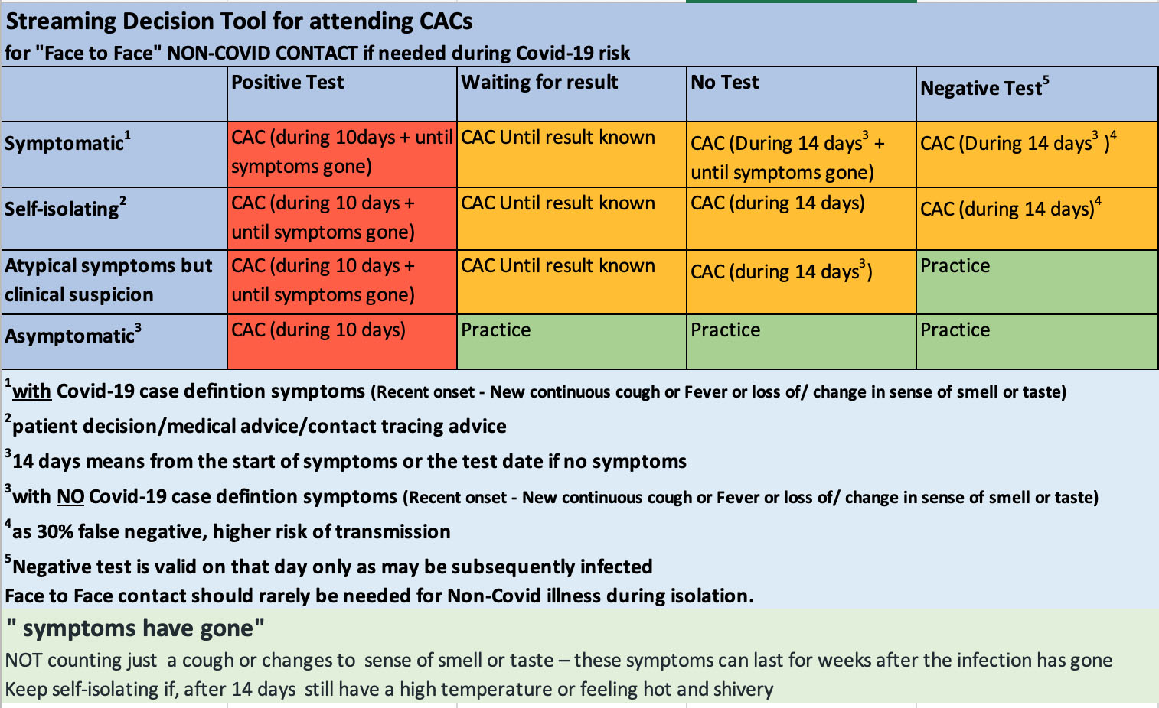
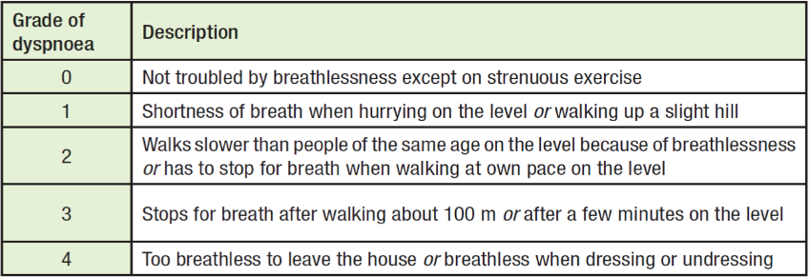
Community Assessment Centres – Who should go there? October 2020
Those who have at least one of these symptoms
OR
Those who are at risk of being infectious and need urgent face to face examination for some other reason
Cough
New (<7days)
Continuous
Fever
Temp >37.8
Loss of/change in sense of smell or taste
Where possible the examination should be deferred till after the possible infective period
AND
New Breathlessness
MMRC>1
OR
Clinical concern or Significantly unwell
BUT WHO DO NOT SEEM TO NEED REFERRAL DIRECT TO SATA
A new continuous cough is where patient:
has a new cough that’s lasted for an hour
has had 3 or more episodes of coughing in 24 hours
is coughing more than usual
MMRC
Referral should state the category of risk above and specify the examination requested. The referrer should follow up the patient once the report is received from the CAC.
Those with no other Covid symptoms but a)who have breathlessness, or b)cough present more than 14 days DO NOT need to be seen at the CAC

